Slide 1
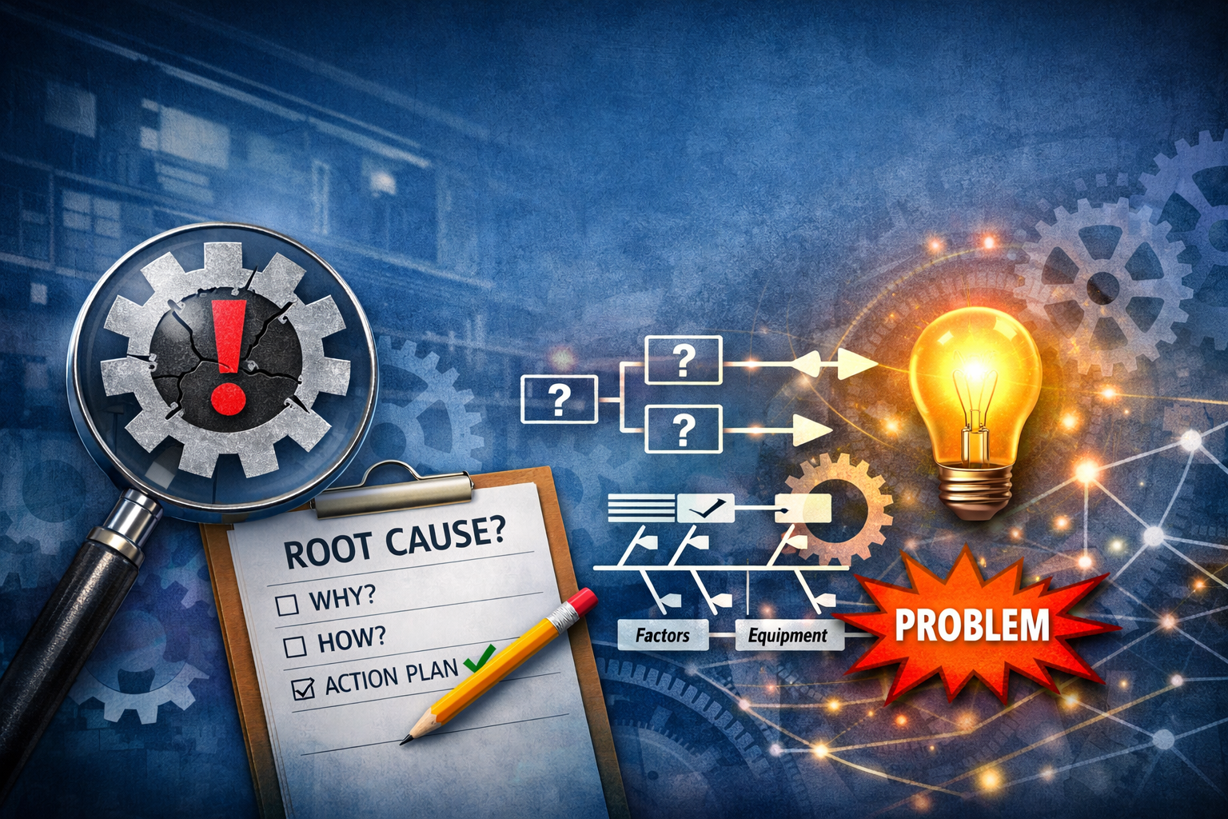

Root Cause Analysis Training
26 Mei 2026 | SPIE Office

Slide 2



Course Objective
To gain an understanding of effective occupational health and safety management in an organization, by providing a framework to:
Explain the purpose and importance of Root Cause Analysis in incident investigation and continuous improvement.
Differentiate between symptoms, immediate causes, contributing causes, and root causes.
Apply basic RCA tools, including the 5 Whys and Fishbone Diagram, to analyze workplace problems.
Develop corrective and preventive actions that address identified root causes and reduce recurrence.
Compile a concise RCA report and communicate key findings and recommendations to stakeholders.

Slide 3
Course Rundown
Time | Activity | Title
09:00 – 10:30 | Module 1-2 | Introduction to Root Cause Analysis Types of Causes and Problem Definition
10:30 – 10:45 | Coffee Break
10:45 – 12:00 | Module 3-4 | RCA Tools: 5 Whys and Fishbone Investigation and Data Collection
12:00 – 13:00 | Lunch Break
13:00 – 14:30 | Module 5 | Developing Actions and Reporting
14:30 – 14:45 | Afternoon Break
14:45 – 16:00 | Module 6 | Case Study and Group Exercise

Slide 4

Module 1
Introduction to Root Cause Analysis
Definition and objectives of RCA;
Benefits for safety, quality, and productivity;
Difference between treating symptoms and eliminating root causes

Slide 5
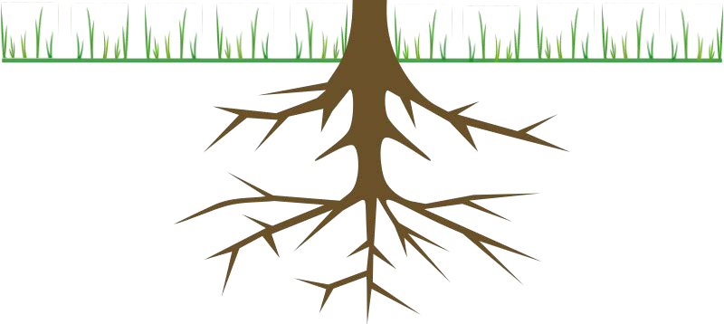
Root Cause Analysis Overview

Slide 6

Purpose
RCA “is a process of analysis to define the problem, understand the causal mechanism underlying transition from desirable to undesirable condition, and to identify the root cause of the problem in order to keep the problem from recurring by using a structured procedure ”
Okes, D., Improve your root cause analysis. Manufacturing Engineering, 2005.
The purpose of any root cause analysis is to find effective solutions to problems such that they do not reoccur

Slide 7

An Investigative Approach
RCA is to be an investigative, data-driven approach to determine the foundation of problems and consequently inform where solutions might be found
An investigative, data driven approach will include:
  Sources (quantitative and qualitative data)
  Intermediate findings (answers that lead to additional questions)
  Findings (conclusions)
Research is the essential element, not intuition or “gut-feeling”

Slide 8
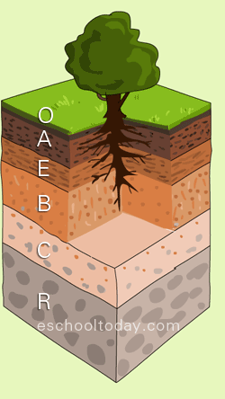
Digging Deep
We really have to dig deep to find most roots
They usually are not the most immediate, obvious, or proximate causes
Often, they are three, four, or five layers down into the system
This will require time, carefully selected RCA members, thoughtful input, and executive commitment and support
Notes:
1. O horizon: The topmost layer consists of organic matter such as decomposing leaves, plant residues, and living organisms like earthworms. This layer is also referred to as the organic horizon.
2. A horizon: Also known as the topsoil, this layer is rich in minerals and organic material. It is usually dark in color and has a high fertility level due to the presence of plant roots and microorganisms.
3. E horizon: Sometimes called the eluviation horizon, this layer is typically found in less mature soils and is characterized by a loss of minerals and clay particles. It is light-colored and often has a sandy texture due to the leaching of materials downward.
4. B horizon: The subsoil or the accumulation horizon consists of materials that leached out from the layers above. It typically contains minerals like iron, clay, and other substances that have been transported from upper horizons.
5. C horizon: Often known as the parent material, this layer is composed of partially weathered or unweathered rock fragments. It serves as the source of minerals and nutrients for upper horizons.
6. R horizon: The bedrock or unweathered rock layer is the deepest layer of the soil profile. It is made up of solid rock and does not contain any soil material.
The composition and arrangement of these horizons can significantly impact the soil's suitability for various uses, such as agriculture, construction, or natural habitat. Soil profiles are valuable tools for studying and interpreting soil properties, determining soil fertility, or assessing potential soil erosion risks.

Slide 9
RCA Process Criteria
An effective RCA process should meet the following four criteria:
Clearly defines the problem(s)
Clearly establishes causal relationships between the root cause(s) and the defined problem
Clearly delineates the known dynamics among those causal relationships on how they combined to cause the problem
Clearly presents the evidence used to support the existence of identified causes
Note: If a FAST chooses to use an already established process for the RCA that is different from the techniques discussed today, it must meet these criteria.

Slide 10


Cautions
There may be several root causes for an event or a problem, thus requiring persistence in sustaining the effort to locate them
In cases of human error, people are rarely the true root cause.
Seek the system, policy, or process that allowed the error to occur.
RCA is not designed to establish blame for a non-conformity, but to correct the underlying cause and prevent re-occurrence

Slide 11

Brainstorming

Slide 12




Why Brainstorming?
Brainstorming and group idea generation will likely be needed several times in the RCA process
RCA is an iterative process from question to answer to question…
When beginning to address a given question, you will likely start with brainstorming
What might be causing this problem?
Where might we look for answers?
Where might we find evidence?

Slide 13

Guidelines
To get the most out of your brainstorming:
Defer judgment –
There are no bad ideas at this point; there will be plenty of time to judge ideas later
Build on the ideas of others – Think in terms of “and” instead of “but”
– If you dislike an idea, challenge yourself to build on it and make it better
Stick to one conversation at a time – Allow ideas to be heard and built upon
Encourage wild ideas –
It’s the wild ideas that often create real innovation
- It is always easy to bring ideas down to earth later

Slide 14
Guidelines (cont’d)
You should also:
Stay focused –
You will get better output if everyone is disciplined
Go for quantity –
Remember there is no need to make a lengthy case for your idea since no one is judging
- Ideas should flow quickly
Be visual –
Try to engage the logical and the creative sides of the brain
- A quick sketch can help make your idea more understandable to someone else

Slide 15
Determine the Cause: Accident investigations aim to identify the root causes and contributing factors that led to the accident. This information is crucial for understanding why the accident happened and what went wrong.
•
Prevent Reocurrence: By uncovering the causes of an accident, organizations can take corrective actions to prevent similar incidents from happening in the future. This might involve improving safety procedures, addressing equipment failures, or providing additional training.
In Safety,
Why do we investigate incidents?
•
Improve Safety: Accident investigations help organizations identify hazards and weaknesses in their safety protocols. This information can be used to enhance safety measures, reduce risks, and create a safer environment for employees, customers, or the public.
•
Legal and Liability Issues: In many cases, accident investigations are necessary for legal and liability purposes. They can help determine who is at fault and whether legal action or insurance claims are warranted.

Slide 16
Why do we investigate incidents?
•
Determine Insurance Claims: When accidents involve property damage or injuries, accurate investigations help insurance companies assess claims and determine appropriate payouts.
Employee Morale: A thorough and fair accident investigation process can positively impact employee morale. Employees are more likely to trust their organization's commitment to safety if they see that accidents are taken seriously and addressed promptly.
Regulatory Compliance: In many industries, there are regulations and standards governing safety and accident reporting. Conducting thorough investigations and complying with reporting requirements is essential for maintaining legal and regulatory compliance.
Learning and Training: Accident investigations provide valuable lessons for employees and organizations. They can serve as case studies for training programs, helping personnel understand the importance of safety measures and how to avoid accidents.
Continuous Improvement: By analyzing accidents and near misses, organizations can identify areas for improvement in their processes and procedures. This continuous improvement approach can lead to a safer and more efficient operation over time.
Public Image: How an organization responds to accidents can affect its public image and reputation. A transparent and diligent investigation process can demonstrate a commitment to safety and responsibility, which can enhance the organization's standing in the community.
•
•
•

Slide 17
Legal, moral, and financial argument for investigations: In Search of Root Cause
Legal
Moral
Financial

Slide 18

The legal argument
•
Often no legal requirement to carry out incident investigations
Carrying out ‘suitable and sufficient’ risk assessment can be a legal requirement
•
•
incidents that are not investigated could indicate that risk assessments are not suitable and sufficient
•
It is good practice to investigate even if there is no legal duty

Slide 19

The moral argument
•
When someone suffers an injury at work, the effects of that incident or harm can extend to many others.
The moral argument for investigating incidents stems from our duty of care.
Lessons can be learned from incident investigations
  Lessons learned can stop workers from being harmed by future work activities
•

Slide 20


The financial argument
•
Incidents cost money to organisations and individuals.
nsurance claims can take a lengthy time to be concluded.
Finding out the cost of an incident can be a good argument for better safety measures within an organisation.
•
•

Slide 21

Management System Requirements (ISO 45001)
Incidents may be classed as a non-conformance
Organisations must have processes in place to manage a non-conformity includes an incident investigations policy.

Slide 22
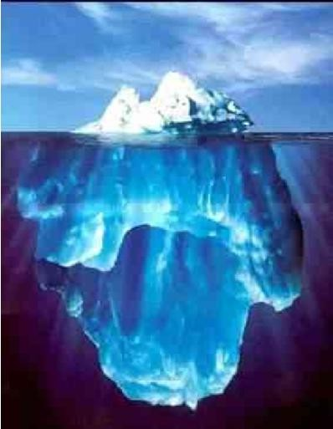
“The Tip of the Iceberg”
Don’t investigate only accidents. Incidents should also be reported and investigated. They were in a sense, “aborted accidents”.
Criteria for investigating an incident: What is reasonably the worst outcome, equipment damage, or injury to the worker?
What might the severity of the worst outcome have been?
If it would have resulted in significant property loss or a serious injury, then the incident should be investigated with the same thoroughness as an accident investigation.
Accidents
Accidents or injuries are the tip of the iceberg of hazards.
Investigate incidents since they are potential “accidents in progress”.
Incidents

Slide 23
Symptom Approach vs Root Cause
If we do a poor job of identifying the root causes of our problems, we will waste time and resources putting band aids on the symptoms of the problem.
Symptom Approach
Root Cause
“Errors are often a result of worker carelessness.”
“We need to train and motivate workers to be more careful.”
“We don’t have the time or resources to really get to the bottom of this problem.”
“Errors are the result of defects in the system. People are only part of the process.”
“We need to find out why this is happening, and implement mistake-proofs so it won’t happen again.”
“This is critical. We need to fix it for good, or it will come back and burn us.”

Slide 24
Common Root Cause Analysis Process
Accident Occurs
Event Occurs
What?
Assess the Situation and Establish
Control Over the Accident Site
Collect Information
Analyze Information
Identify Critical Events
Search for Root Causes
Why?
Prevent!
Identify Findings and Recommendations
Report Results
Follow-Up on Implementation

Slide 25
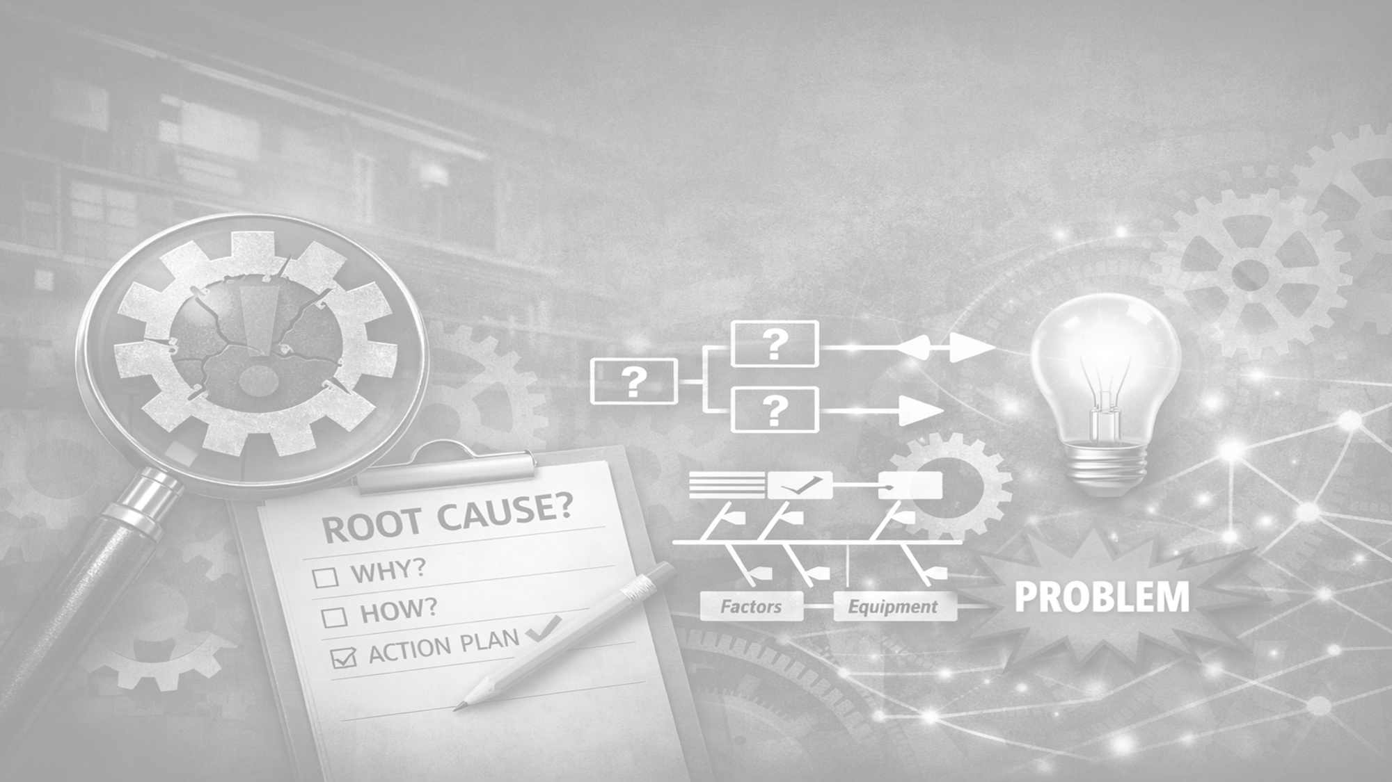
End of Module 1
Discussion & Questions Session
Definition and objectives of RCA;
Benefits for safety, quality, and productivity;
Difference between treating symptoms and eliminating root causes.

Slide 26
Module 2
Types of Causes and Problem Definition
Symptoms vs immediate, contributing, and root causes;
Common human, technical, and organizational factors;
Writing a clear problem statement.

Slide 27
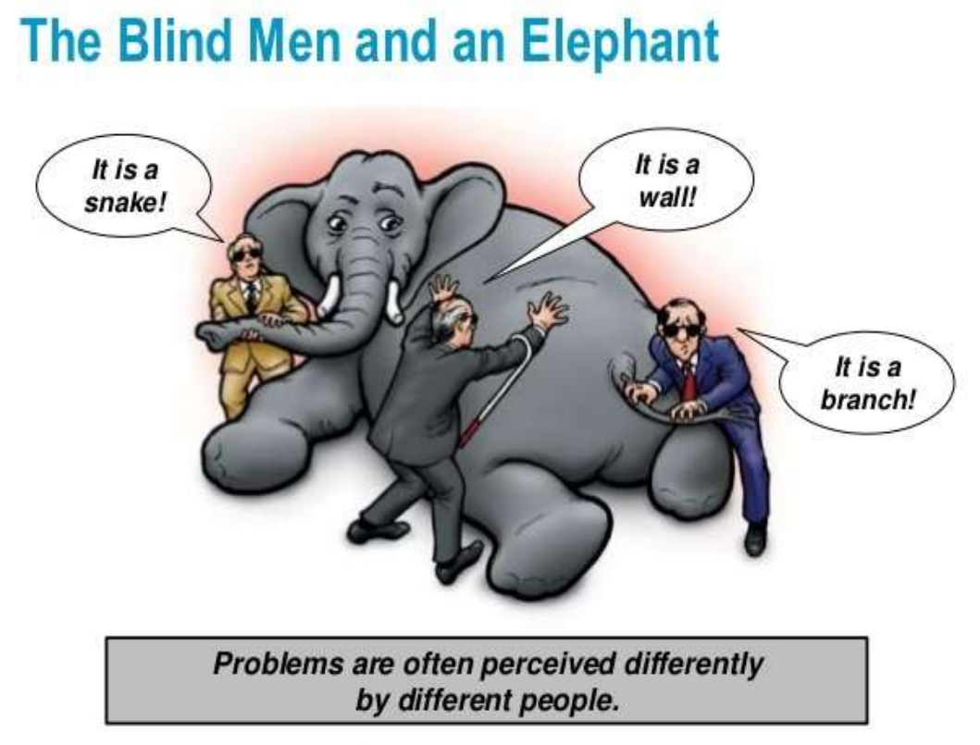

Slide 28
Giving up problems due to wrong approach in problem solving
Noticing an abnormality
Giving up
Finding a
quick fix to abnormality
Running away
Recurrence
of abnormality
Blame Game
Re-fixing
the abnormality
Irritation
Recurrence
of abnormality
Frustration
Re-fixing the abnormality

Slide 29
Giving up problems due to wrong approach in problem solving
Noticing an abnormality
Standardization and monitoring
Communicating the problem
Lessons Learnt
Setting up a
problem solving team
Finding and
implementing preventive actions
Defining the problem
Finding and implementing corrective actions
Planning and initiating containment
Find actual cause/ causes
Finding potential causes

Slide 30
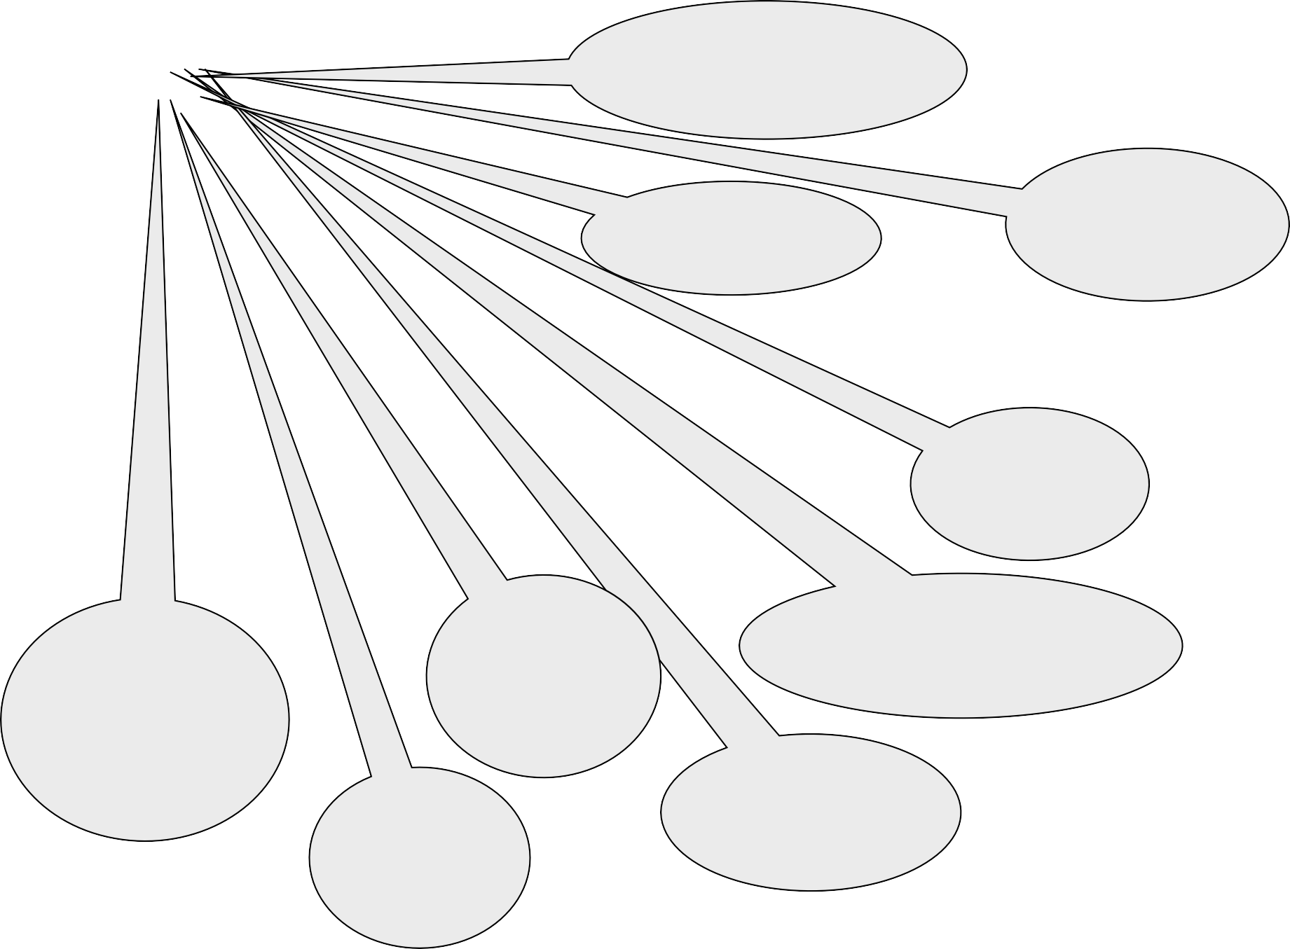
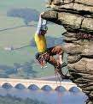
Problem Solving Challenges
Challenges
Management impatient for a quick fix
Poor team participation
Lack of Procedures
No logical thought process
Lack of technical skills/ knowledge
Potential causes mis- identified as root cause
Problems solving steps skipped to obtain a quick solution
No priorities, Resources, Approvals
Problem defined in- correctly

Slide 31
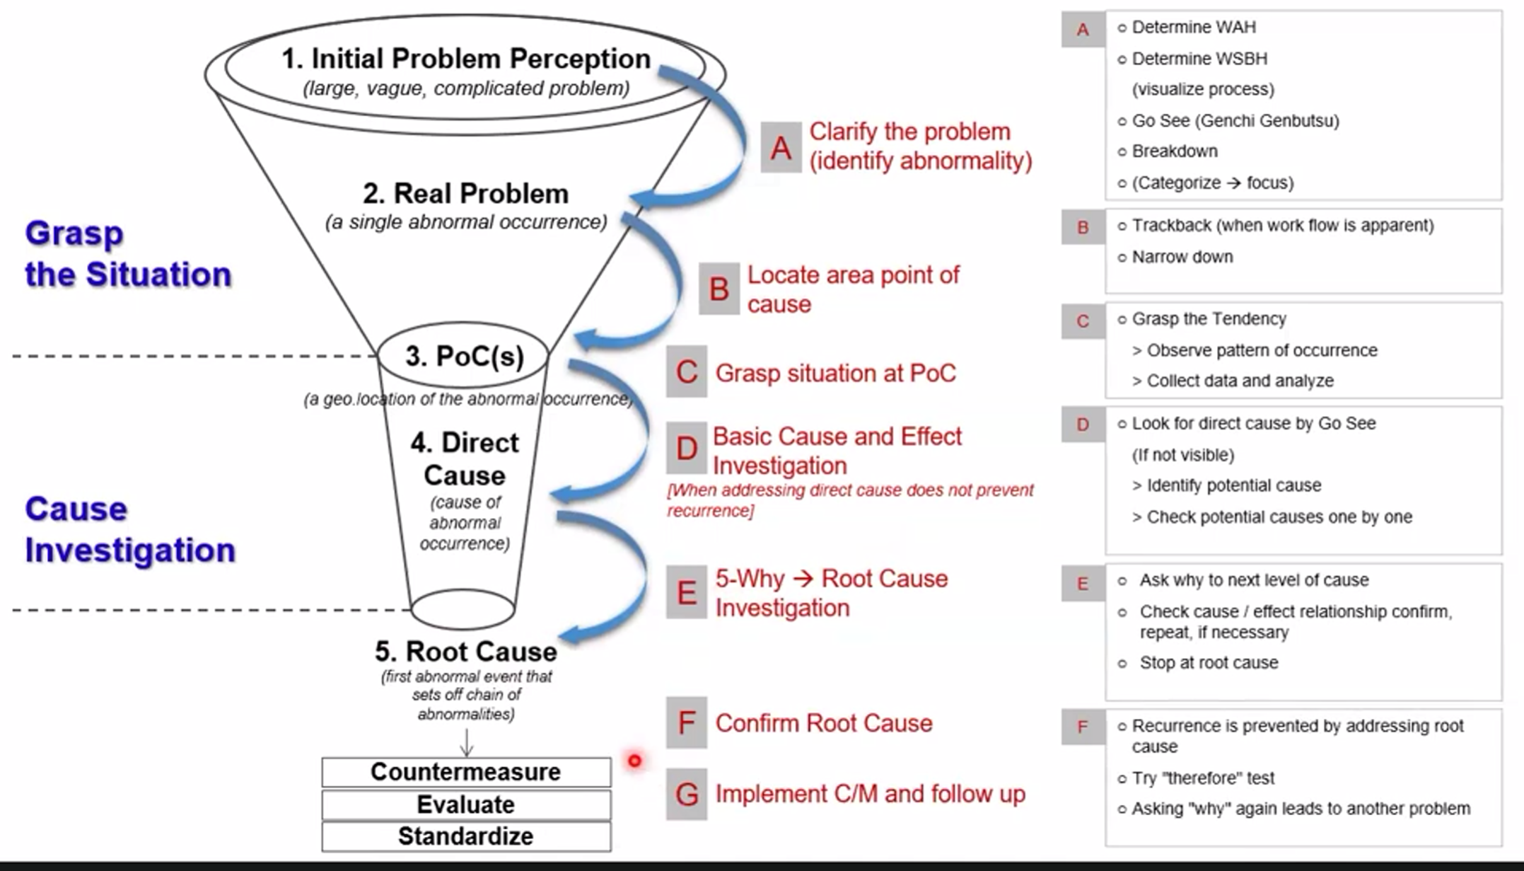
Basic Elements of the Problem

Slide 32
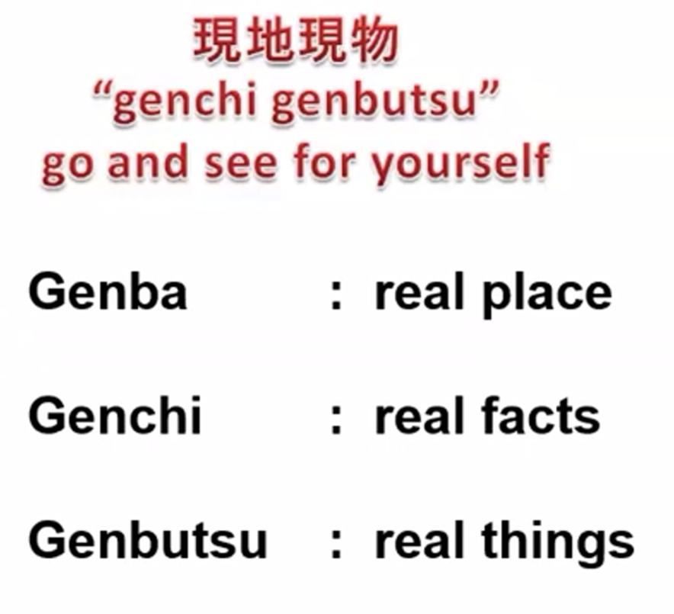
1. Initial Problem Perception
Clarify the problem --> to understand the problem
Divide problem into small/focus problem → stratification
Don’t jump to the conclusion
Try to find What Actual Happened (WAH)
Try to find What Should be Happen (WSBH)
Visualize process flow
Asked questions
GENBA – GENCHI - GENBUTSU

Slide 33
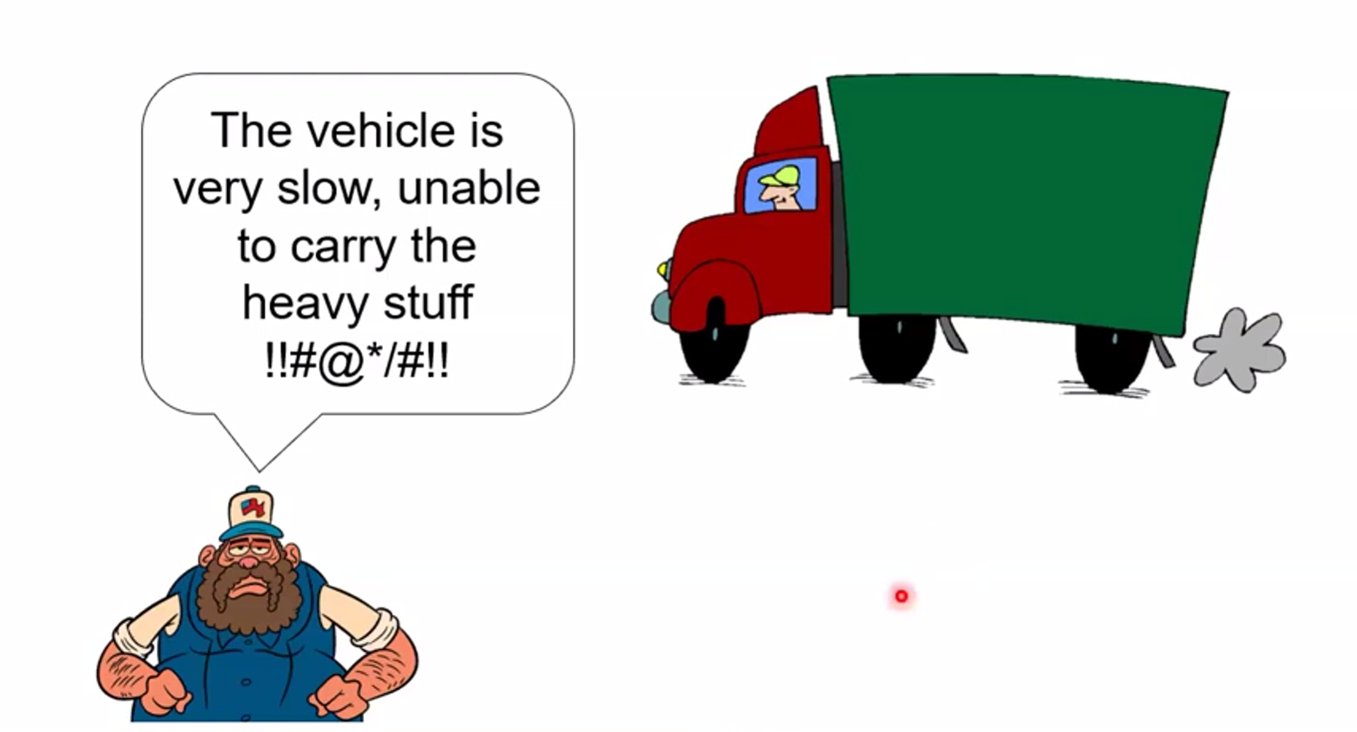
1. Initial Problem Perception - Example

Slide 34
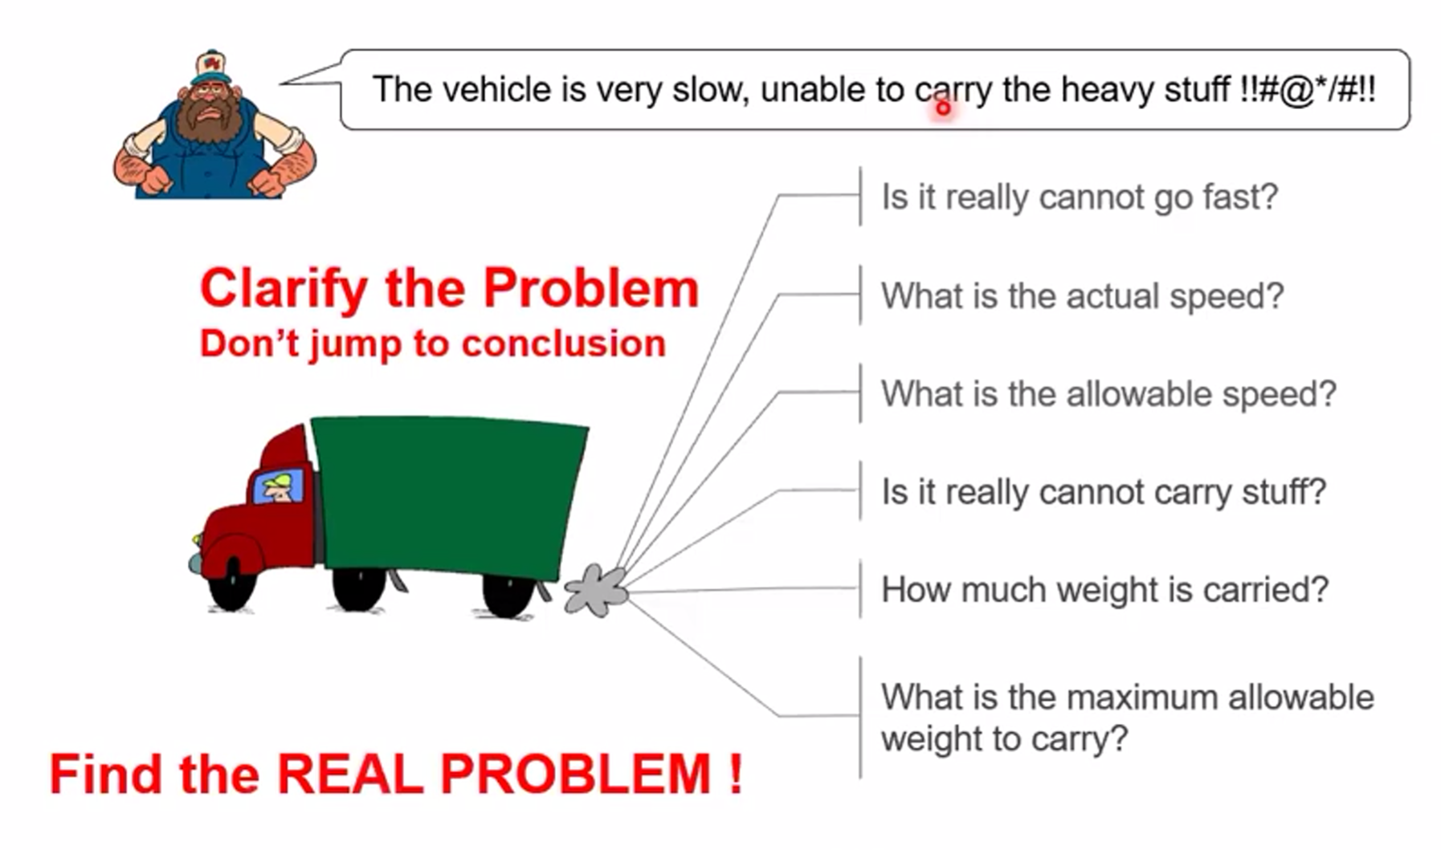
1. Initial Problem Perception - Example
The vehicle is very slow, unable to carry the heavy stuff !!#@*/#!!

Slide 35
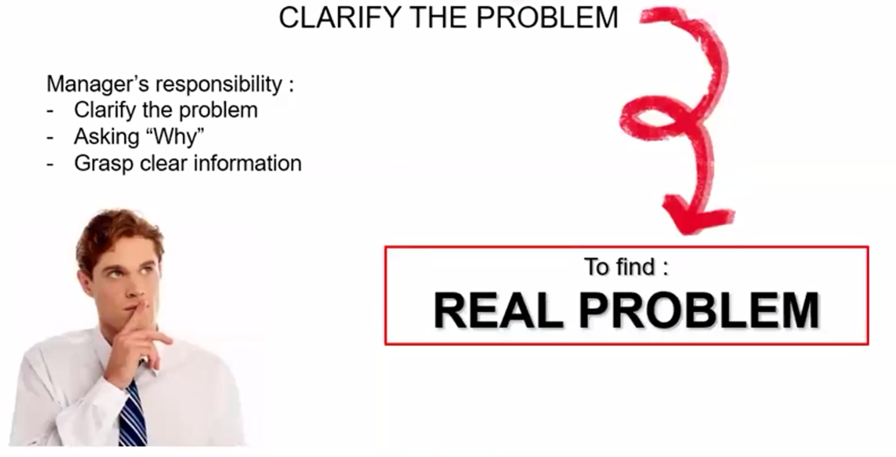
2. Real Problem

Slide 36
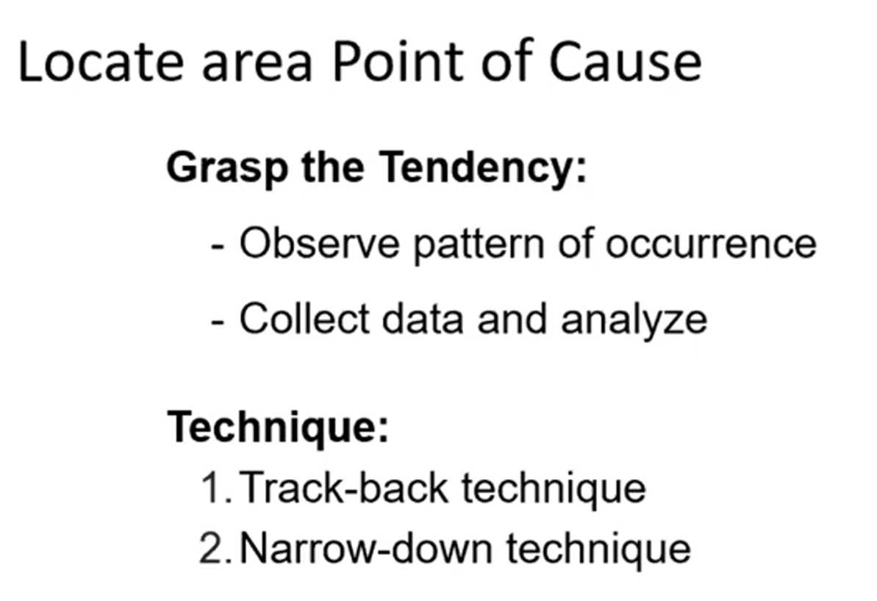
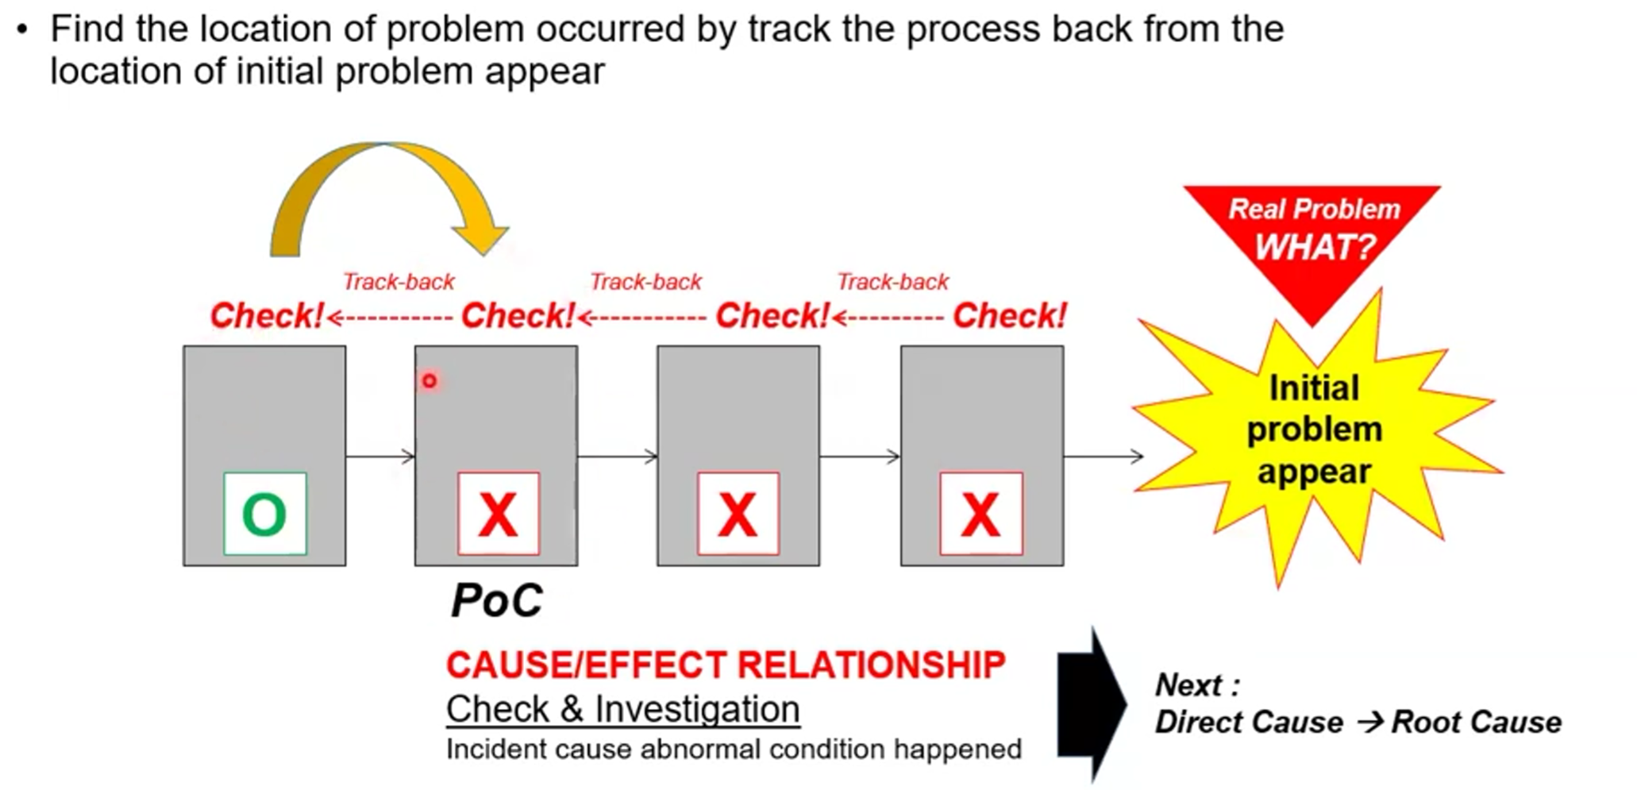
3. Point of Cause (PoC)

Slide 37

3. Point of Cause (PoC) - Example

Slide 38
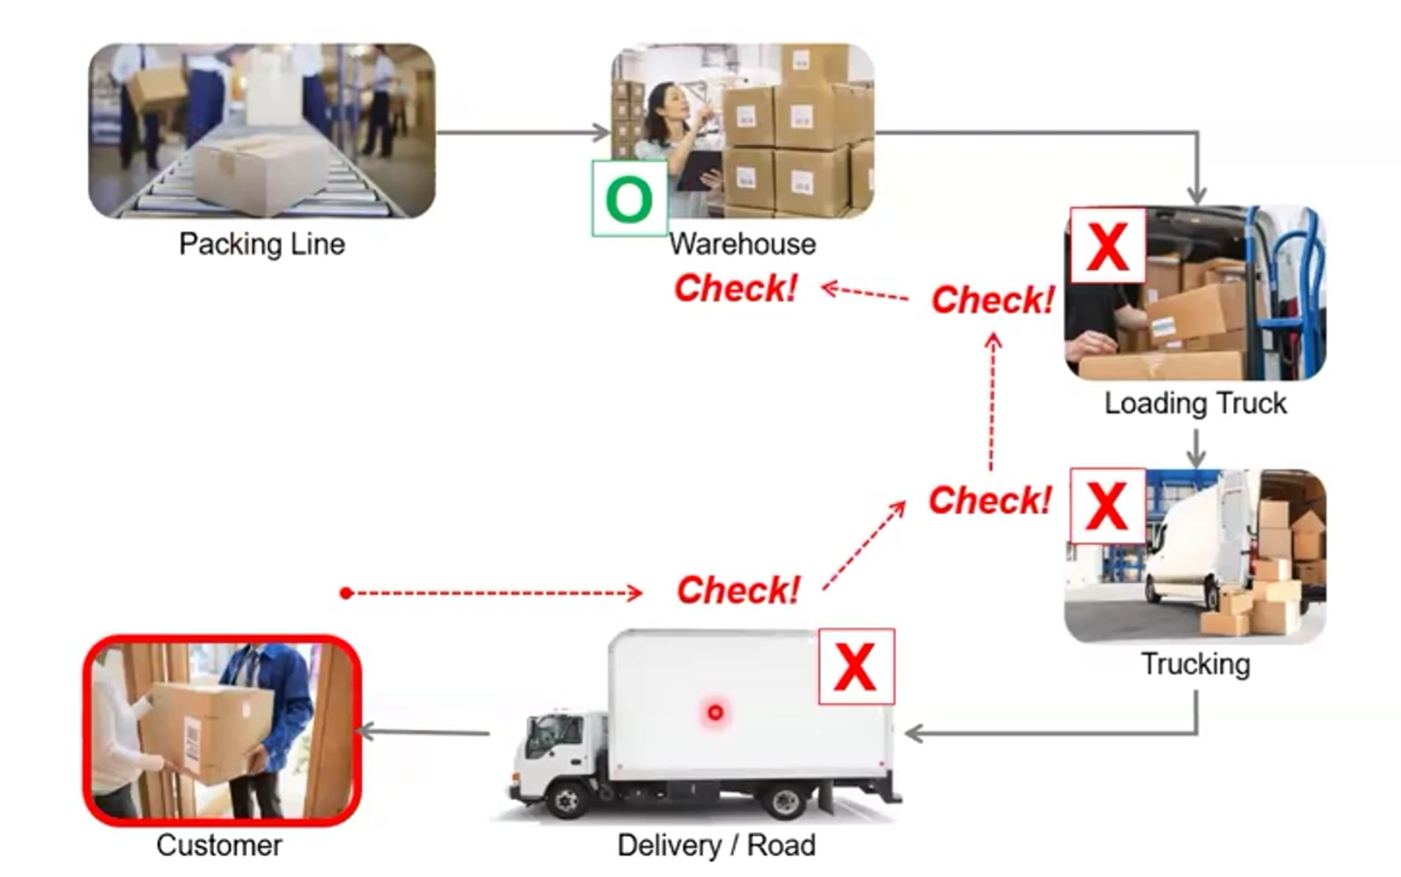
3. Point of Cause (PoC) - Example
PoC

Slide 39
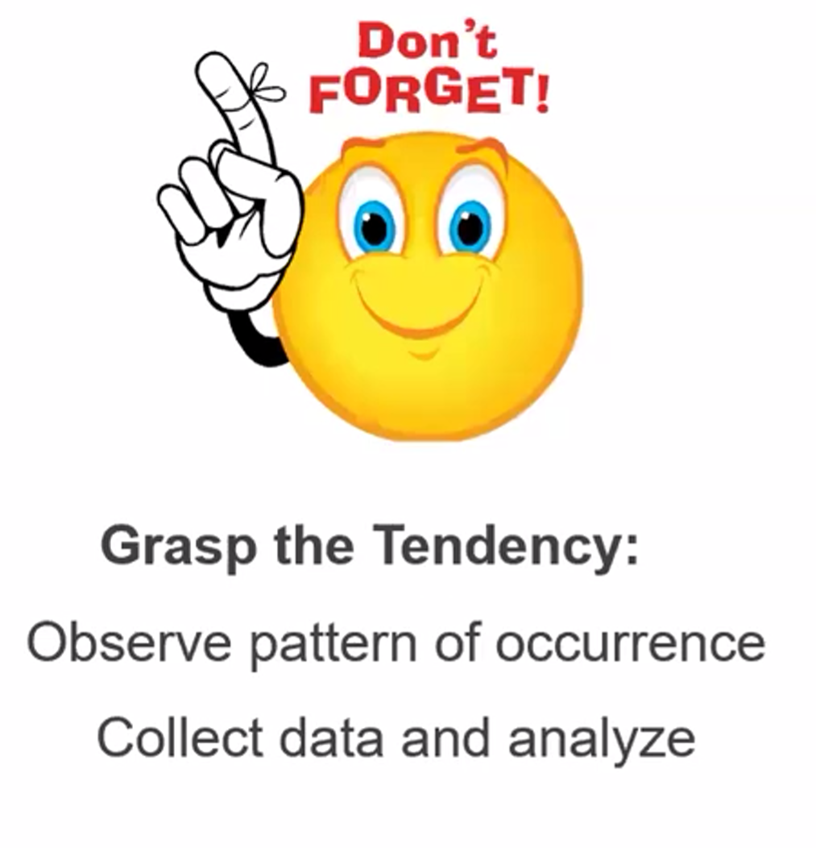
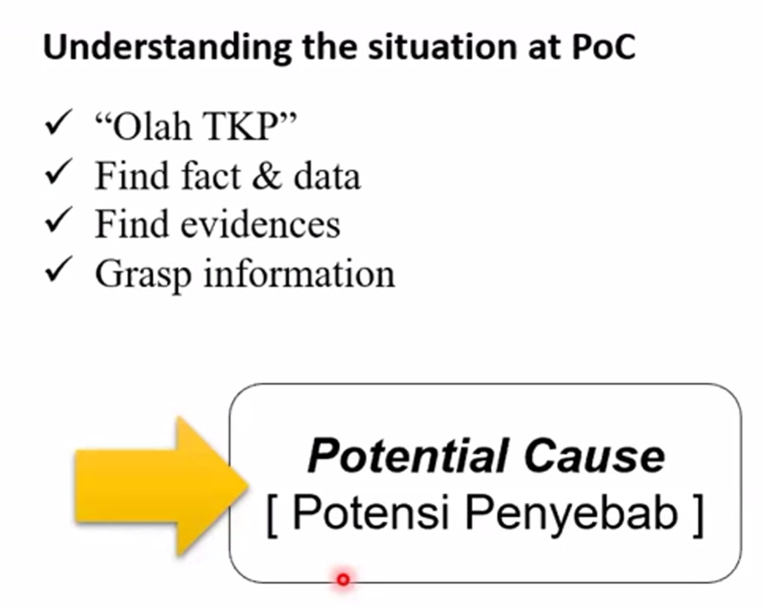
3. Point of Cause (PoC)

Slide 40

4. Direct Cause

Slide 41
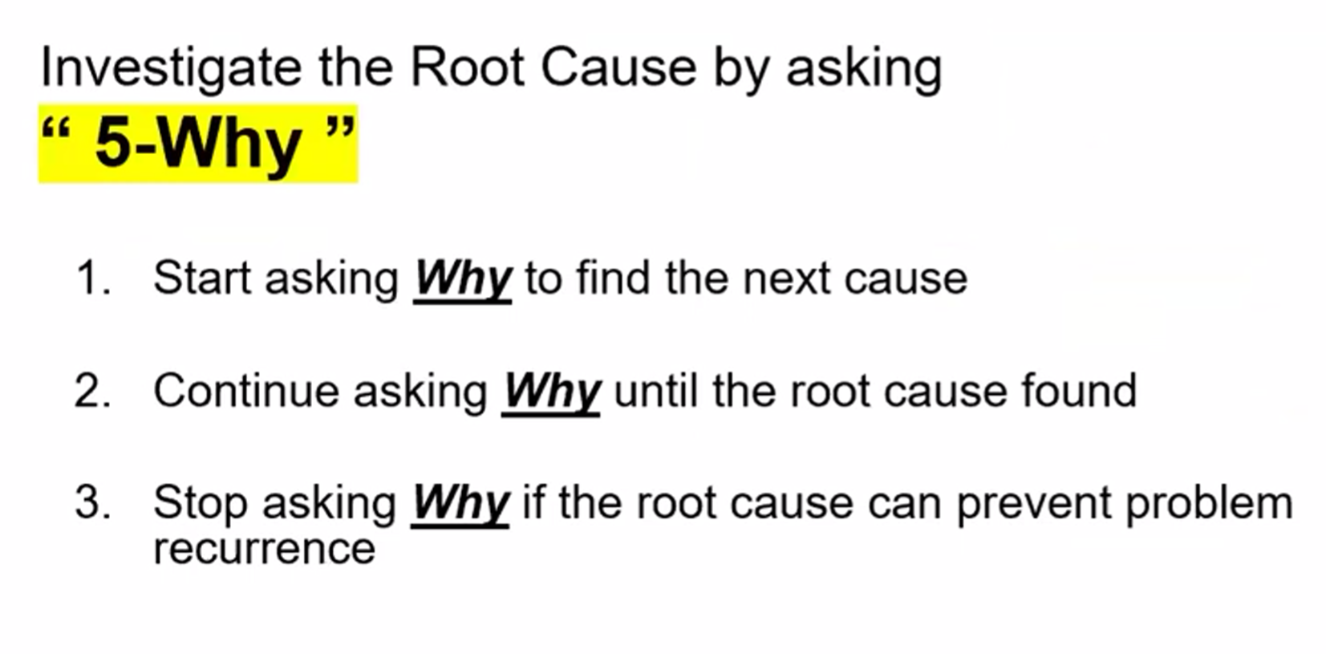
5. Root Cause

Slide 42
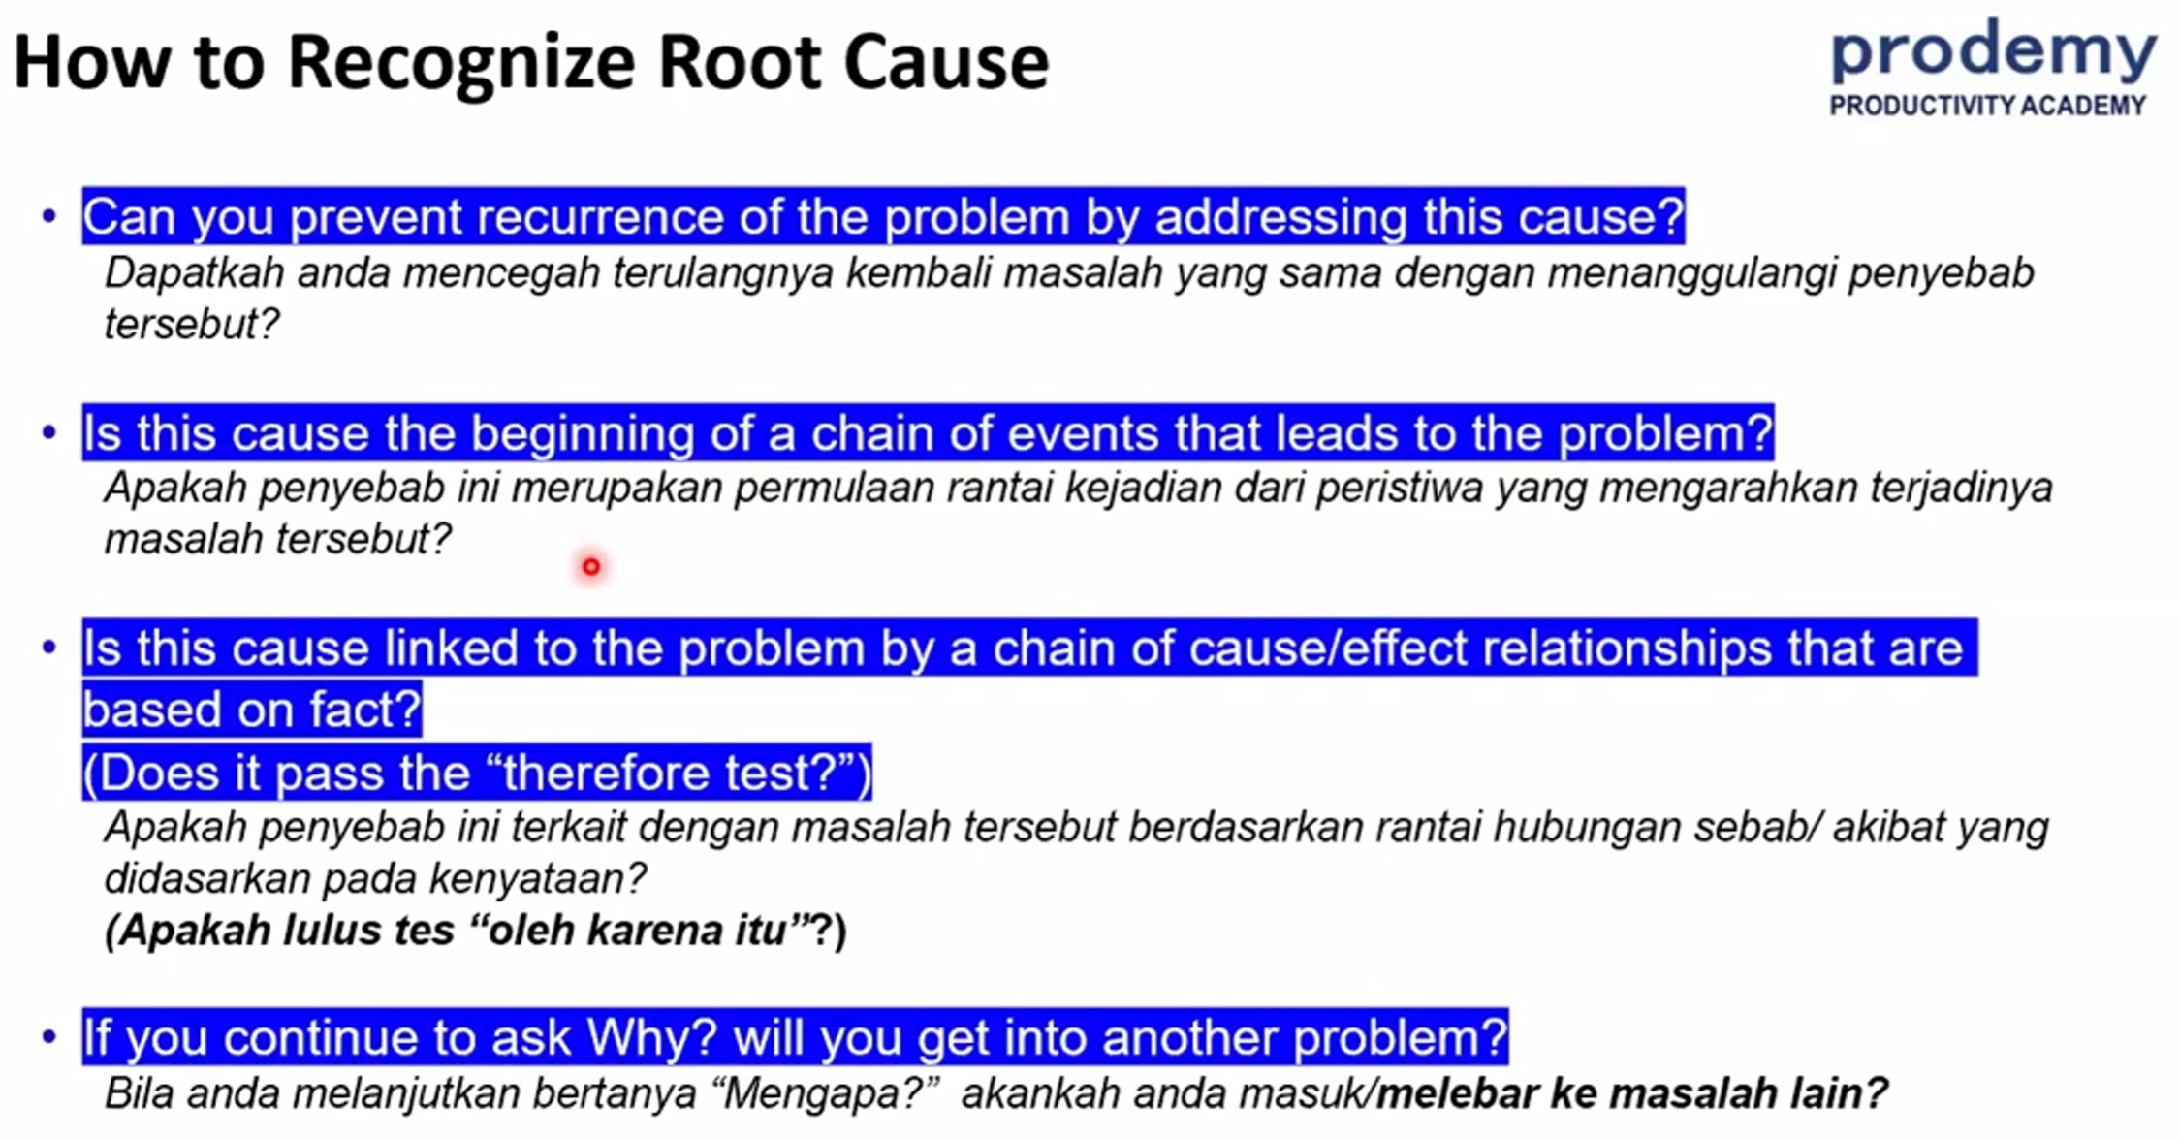
5. Root Cause

Slide 43
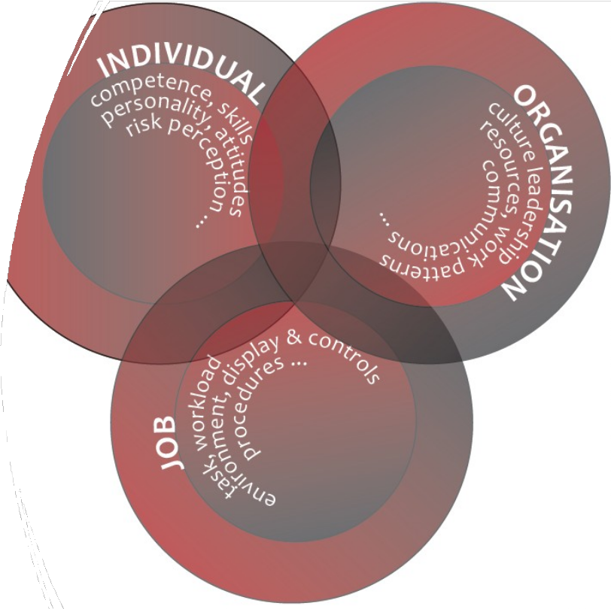
Factors that can contribute as causes to an incident.
Human factors are split into components:
  job factors;
  individual factors; and
  Organisation and management factors.

Slide 44

Job factors
Poor design of equipment and instruments.
Interruptions and disturbances.
Unclear or missing instructions.
Poorly maintained or faulty equipment.
High demand/workload.
Unpleasant working environment, eg noisy, dirty, poor lighting, etc.

Slide 45


Individual factors
Overworked, tired workers.
Lack of competence in the work activity, or with a piece of equipment.
Workers carrying out activities that are beyond their capability.
Complacency.
Low morale/boredom.
Medical conditions/medication that causes drowsiness.

Slide 46

Organisational factors
Lack of appropriate planning.
Lack of a safe system of work in place prior to work starting.
Inadequate resources allocated to work activities.
Poor design of equipment or workplace layout, or poorly maintained equipment.

Slide 47

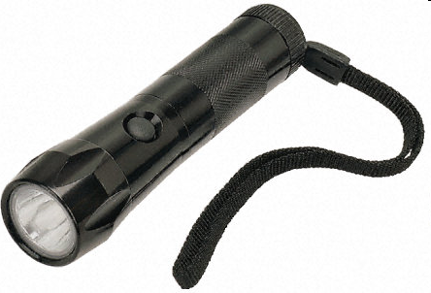
Warm-up problem: My flashlight does not work! WHY?
Exercise
Notes:
Context: An operator came to you mentioning the flash light does not work

Slide 48
Warm-up problem: My flashlight does not work! WHY?
Exercise

Slide 49
End of Module 2
Discussion & Questions Session
Symptoms vs immediate, contributing, and root causes;
Common human, technical, and organizational factors;
Writing a clear problem statement.

Slide 50
Module 3
RCA Tools: 5 Whys and Fishbone
Principles of 5 Whys;
Steps to build a Fishbone (Ishikawa) Diagram;
Basic cause-and-effect mapping;
Tips to avoid bias when brainstorming causes.

Slide 51
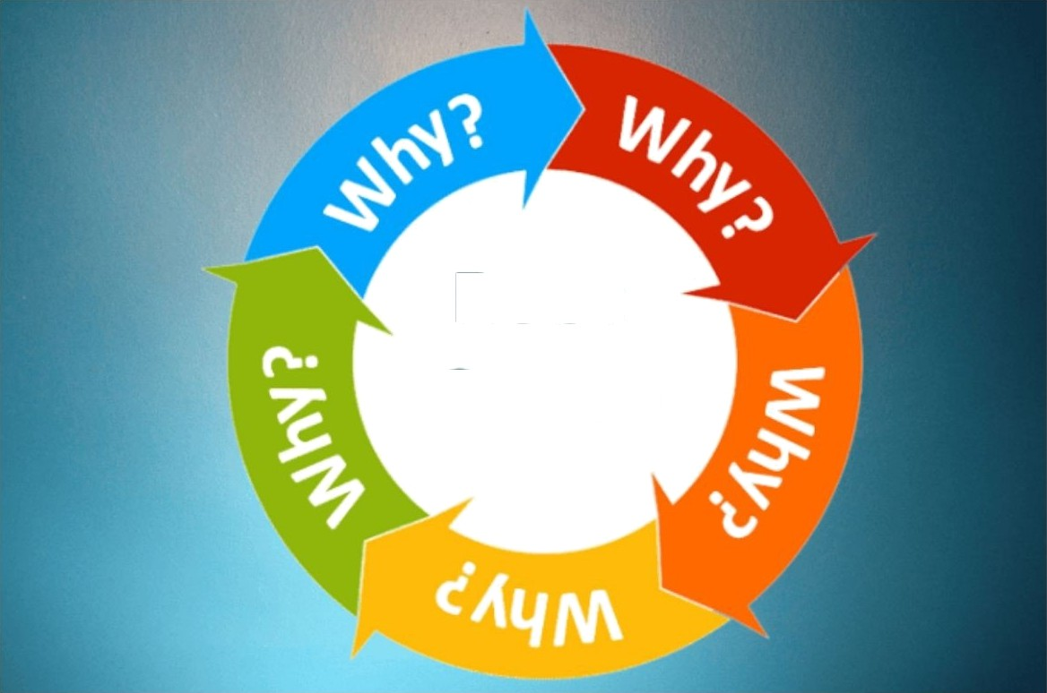
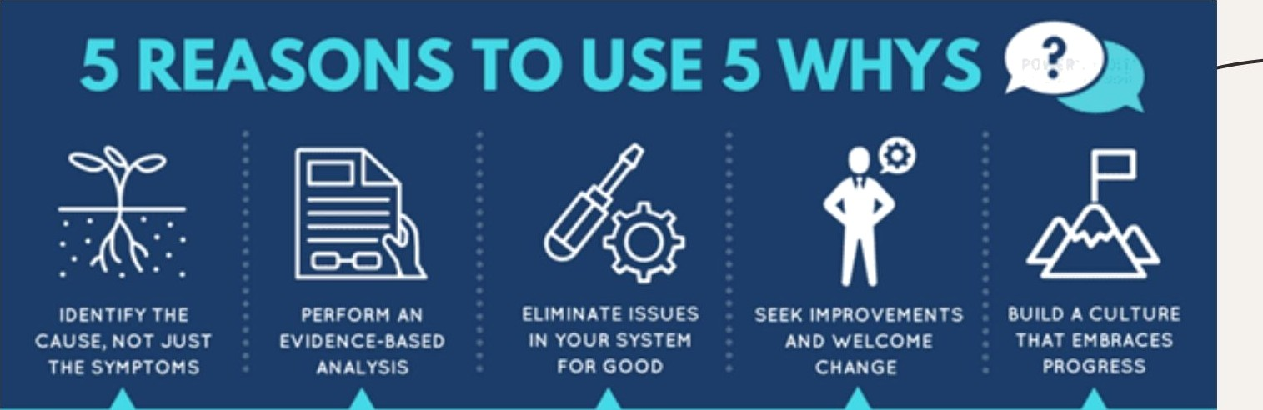
What are the 5 Why Techniques?
The S Why Techniques is a simple yet elective method for identifying the root cause of a problem. It involves asking 'why' five times to get to the underlying cause of an issue.
Root
Cause
When to Use the 5 Why Techniques
The 5 Why Techniques is best used when dealing with complex problems that require a deeper understanding of the underlying causes. It can be used in any industry or field.

Slide 52

How to Use the 5 Why Techniques
To use the 5 Why Techniques, start by identifying the problem and asking 'why' five times to get to the root cause. Then, develop and implement a solution to prevent the problem from recurring.

Slide 53

Example: Production Delays
Problem: Production delays.
Why? Machine breakdown.
Why? Poor maintenance.
Why? Lack of training.
Why? Inadequate budget.
Why? Management decision.
Solution: Increase budget for maintenance and training.

Slide 54
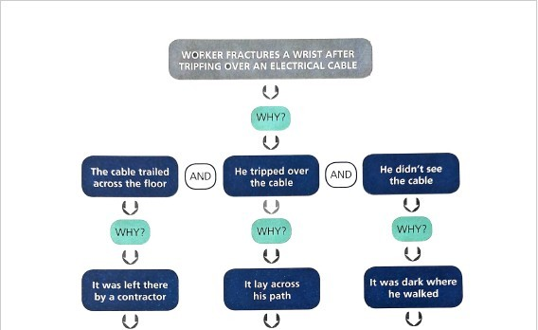

Slide 55
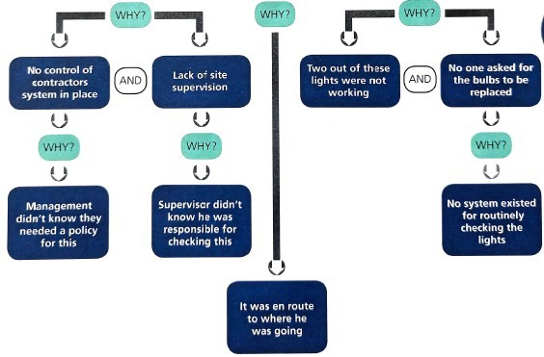

Slide 56

Benefits of the 5 Why Techniques
The S Why Techniques provides a deeper understanding of problems, allows for the development of elective solutions, and prevents problems from recurring. It also promotes a culture of continuous improvement.

Slide 57

Common mistakes when using the 5 Why Techniques include stopping at symptoms, not asking 'why' enough times, and not involving the right people. Avoid these mistakes to ensure elective problem-solving.

Slide 58

Tips for Success
To ensure success with the 5 Why
@ Techniques, involve a cross-functional team, use data to support your analysis,
and be open to multiple solutions.
Remember to also follow up on implemented solutions.

Slide 59
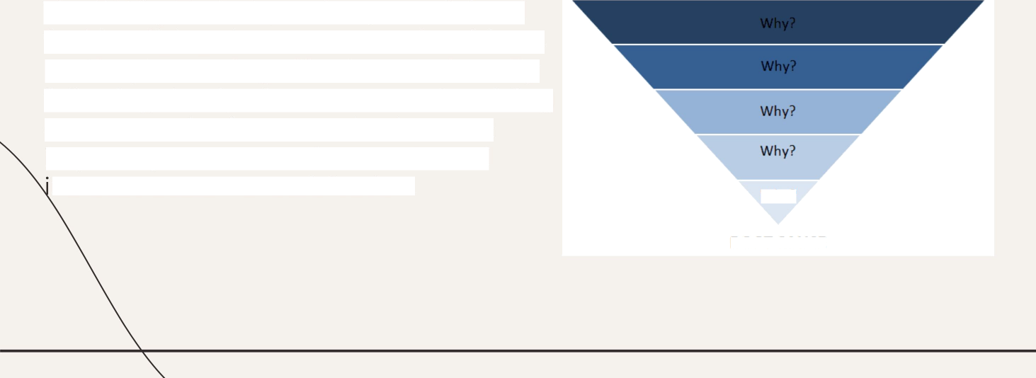
Conclusion
PROBLEM:
The S Why Techniques is a powerful tool for identifying the root cause of problems and implementing elective solutions. By following the tips for success and avoiding common mistakes, organizations can improve processes, reduce costs, and ncrease customer satisfaction.
Why?
ROOT CAUSE

Slide 60








A Fishbone Diagram is a structured brainstorming tool using categories to explore root causes for an undesirable effect.
Categories
Causes
Fishbone Theor

Slide 61
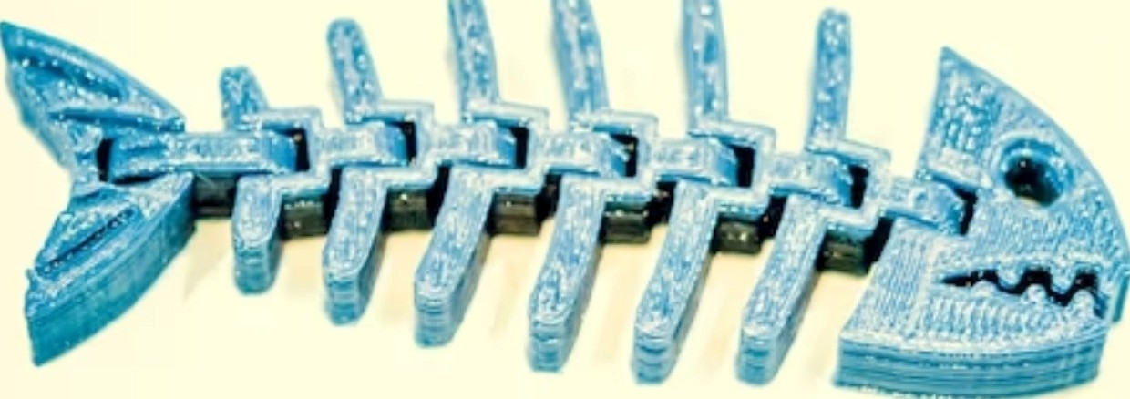
What is Fishbone Theory?
Fishbone Theory, also known as Ishikawa diagram, is a problem-solving tool used to identify the root causes of a problem. It's a visual representation that helps to identify the potential causes of a problem and categorize them into diPerent groups. By analyzing the causes, we can find the root cause and take corrective action.

Slide 62

The Anatomy of Fishbone Diagram
A Fishbone Diagram is divided into six categories: People, Process, Product, Environment, Equipment, and Policy. Each category represents a potential cause of the problem. The
diag ram starts with the problem statement at the head of the fish and the po\entiaI ca uses are listed on the bones.

Slide 63

The Benefits of Fishbone Theory
Fishbone Theory provides a visual and collaborative approach to problem-solving.
It helps to identify the root cause of the problem and prevent it from recurring.
It also promotes teamwork and communication, as it involves people from diPerent departments and levels of the organization.
By using Fishbone Theory, we can improve the quality of our products and services, reduce costs, and increase customer satisfaction.

Slide 64

To create a Fishbone Diagram, follow these steps:
Define the problem statement
Draw the fishbone diagram and label the six categories
Brainstorm potential causes and write them on the bones
Analyze the causes and identify the root cause Take corrective action to eliminate the root cause
How to Create a Fishbone Diagram

Slide 65

To conduct an effective Root Cause Analysis,
follow these tips:
Tips for Effective Root Cause Analysis
Involve a cross-functional team Define the problem statement clearly Use data to support your analysis
Focus on the root cause, not the symptoms
Take corrective action immediately

Slide 66

Common Mistakes to Avoid
To avoid common mistakes in Root Cause Analysis, be aware of:
Bumping to conclusions without analyzing the data
Blaming individuals instead of focusing on the process
Not involving the right people in the analysis
Treating the symptoms instead of the root cause
Not taking corrective action immediately

Slide 67


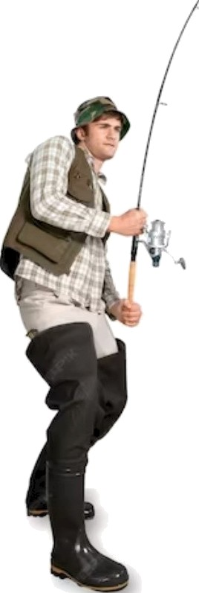
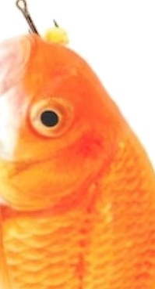


Fishbone Theory in Action
Now that you know the basics of Fishbone Theory, it's time to put it into action. Identify a problem in your organization and create a Fishbone Diag ra m to find the root ca use. Involve a cross-functional tea m and use data to support your
analysis. Ta ke corrective action and monitor the results. Let's un leash the power of Fish bone Theory!

Slide 68
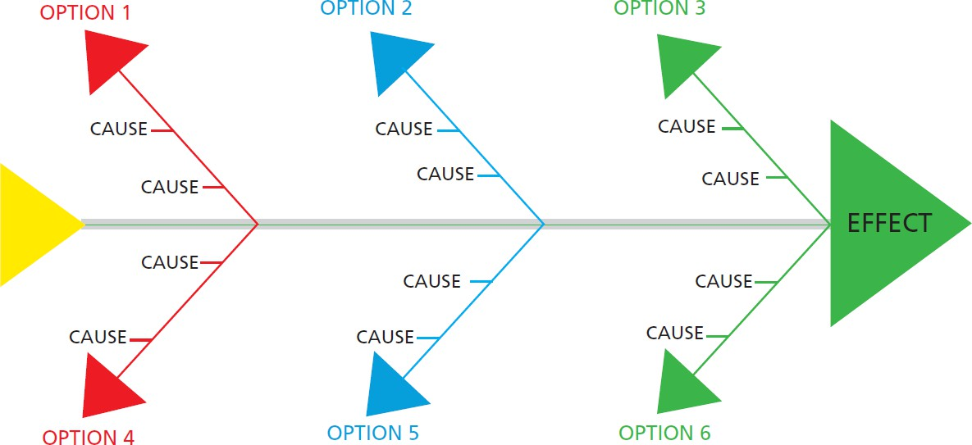

Slide 69

Conclusion
Fishbone Theory is a powerful tool for Root Cause Analysis that can help you identify and eliminate the root causes of problems.
By using a visual and collaborative approach, you can improve the quality of your products and services, reduce costs, and increase customer satisfaction.
Remember to involve a cross- functional team, define the problem statement clearly, use data to support your analysis, and take corrective action immediately.
Let's navigate the murky waters of Root Cause Analysis with Fishbone Theory!

Slide 70
GROUND RULES for RCA

Slide 71


Ground Rules are…..
Avoid Idea Killers
Everyone participates
Full attention required
Respect one another (Turn off Phones, close up laptops)
Think “outside the box”
  Consider different approaches
Manager XYZ won’t support this idea
Suggest concrete ideas
  Formulate concrete and “doable” ideas
  No idea is a poor idea
It won’t work anyway
That is too complicated
Don’t stomp on an idea
  Build on someone’s idea to make it better
We are already better than most plants, why bother?
It’s too risky
Think about solutions, not only problems
This is a known issue and fixable
No evaluation
  Evaluate ideas after brainstorming
We thought about this 2 years ago!
Notes:
Have Fun
Set some ground rules to have fun in the class
Encourage participate in the discussion
All input are welcomed
Avoid Idea Killers
Remember the Ground Rules are….

Slide 72
End of Module 3
Discussion & Questions Session
Principles of 5 Whys;
Steps to build a Fishbone (Ishikawa) Diagram;
Basic cause-and-effect mapping;
Tips to avoid bias when brainstorming causes.

Slide 73
Module 4
Investigation and Data Collection
Collecting facts and evidence;
Simple interviewing techniques;
Reviewing records, photos, and data;
Validating information before analysis.

Slide 74

The process of Investigating incidents

Slide 75


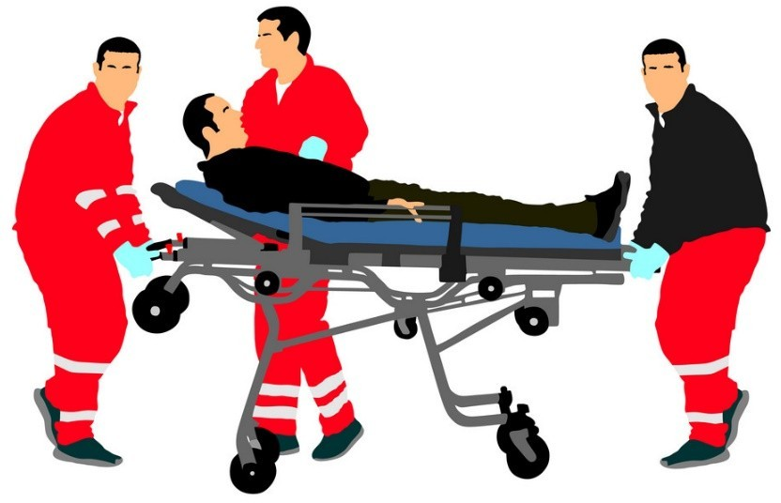
1. Make Sure the injured person is looked after
Make sure the injured person gets immediate attention and administrate first aid and shift him to a medical facility if it is required

Slide 76

2.Secure the Scene
Next step is to ensure the safety of the investigators and preserve the accident scene. This may involve securing the area, isolating any hazards, and providing medical attention to injured individuals.

Slide 77

3. Report the incident
Notify Relevant Parties: Inform appropriate personnel and authorities about the accident. This may include notifying emergency services, management, regulatory agencies, and any other relevant parties.

Slide 78

4. Assemble the investigation team
Assemble a team of qualified individuals who have the expertise and knowledge necessary to conduct the investigation effectively. This team may include following people based on the type of accident
Employees with experience in the field. Area or work supervisor.
Safety officer.
Committee on health and safety. Representative of the union, if applicable.
Employees who have experience conducting investigations. “External” experts.
Local government or police representative.

Slide 79

5. Gather Information:
Collect Physical Evidence: Examine the accident scene to gather physical evidence such as photographs, video footage, equipment, and materials involved.
Interview Witnesses: Interview individuals who were present at the time of the accident, including victims, employees, and any other relevant personnel.
Review Documentation:
Typical documentation that you will look at during any investigation are :
Risk Assessments, Safe Systems of Work, Permits to Work, Method Statements, Training Records
Work Procedures, Job Guides, Previous Accidents in work, Near Miss Reports, Previous Audits.
Depending on the type of accident, you will also examine things like: pre use check sheets, workplace inspections, statutory test certificates and medical records to establish if the person was on restricted duties.

Slide 80

6. Analise Findings
•
Identify the Sequence of Events: Create a detailed timeline of events leading up to the accident, during the accident, and immediately afterward. This helps in understanding the chain of events that led to the incident.
Look at what is relevant to the incident, in a timely, structured manner.
Have all reasonable lines of enquiry been followed? Is there any information missing? If so, why?
Common themes from these interviews must be recorded.
All possible causes and consequences of the incident should be considered.
Establish the immediate, underlying and root causes (including human factors)
Establish what happened and why (5-Whys)
Identify all causes of the incident (including human factors where applicable)
Record all causes and additional risk control measures required
Identify control measures (existing and/or additional) for each cause
Use of a timeline can help during the ‘analysis’ step

Slide 81

6. Develop Recommendations and action plan
Based on the investigation findings, develop recommendations for corrective actions and preventive measures. These recommendations should address the identified root causes and aim to prevent similar accidents in the future.
Implement Corrective Actions: Once the recommendations have been developed and approved, take action to implement the corrective measures. Assign responsibilities and establish timelines for these actions.
Monitor and Review: Continuously monitor the effectiveness of the corrective actions and review the progress. Adjust the measures if necessary and ensure that they are sustained over time.

Slide 82




Findings of the investigation must be communicated
Understand what lessons can be learned from the incident
Post-investigation actions
Additional controls implemented are analysed to determine their effectiveness
Witnesses and casualties are supported through any trauma they may have experienced

Slide 83

Incident investigation – Interview Techniques
Reasons for carrying out prompt interviews
Witnesses may forget things if not interviewed quickly.
The brain can alter memories, especially after a trauma.
If witnesses have an opportunity to discuss the incident among themselves, their memories may be altered by other people's opinions.

Slide 84
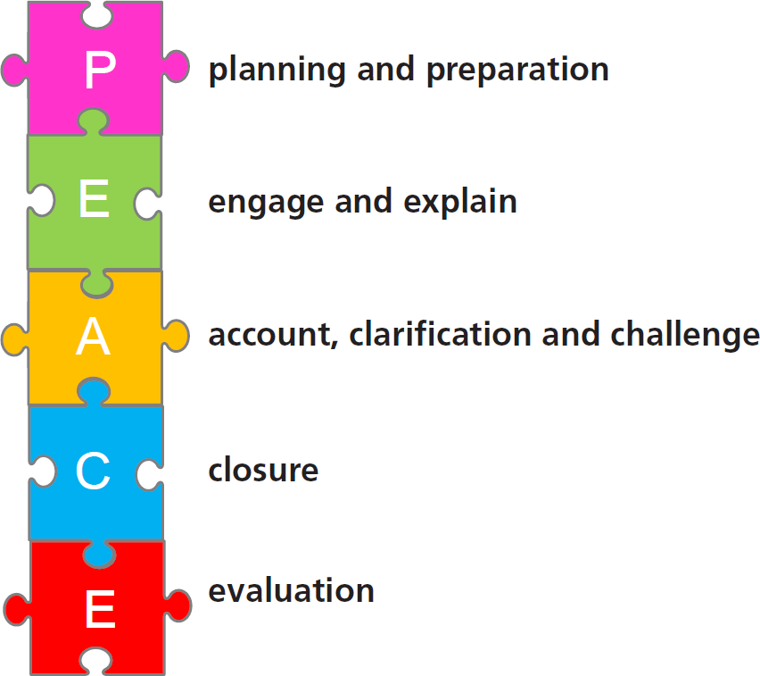
The PEACE model for interviewing

Slide 85

Planning and preparation
Interview one person at a time, and use a scribe to help the interview flow better.
Others may also be required to be present eg:
  trade union/worker body representation;
  translator;
  buddy;
  Human Resources representative; and
  solicitor/lawyer who may be representing the employer OR the interviewee.
•

Slide 86
Getting the location right is important
  somewhere quiet, without distractions or interruptions
  on site or off site interviews.
Allow sufficient time for the interview to be conducted thoroughly, how ever long that may take.
Prepare an interview plan, based on the facts that need to be established – ie, aims and purpose of interview.
Establish a timeline to plot the sequence of events during interview.
Planning and preparation

Slide 87

Planning and preparation
There are benefits and limitations to holding interviews on site:
The incident site can be visited during interview to clarify positions.
Interviewees will be familiar with the site.
It feels less formal so may make an interviewee feel more comfortable.
✗
✗
Interruptions during interview, due to the proximity.
Post-traumatic stress for the interviewee after witnessing an incident in the vicinity of the interview room.

Slide 88


Engage and explain
Establish with the interviewee:
The aims and objectives of the interview.
any individual needs they may have.
rapport.

Slide 89

Engage and explain
Use open questions to gather the initial information.
never use leading questions, or prompt an answer from an interviewee.
Do not ask lots of questions at the same time
closed, targeted questions can be used after the initial information gathering, to establish specific facts.
avoid the use of jargon.
ensure the initial rapport established is continued throughout the interview.

Slide 90

Active listening
•
One of the most important tools that an interviewer can have.
Active listening is not the same as hearing. Hearing is about being aware of sounds.
Listening requires action - you need to concentrate so that:
you process and understand the meaning of the message; and
can respond accordingly.
•
•

Slide 91



Active listening
Hearing
Attending Understanding Remembering

Slide 92


Account, clarification and challenge
The interviewer must decide if there are:
areas for further exploration/investigation;
any inconsistencies in evidence gathered (this must be clarified with the interviewee); and
Challenge any contradictions from the interviewee based on information already supplied and/or other evidence gathered.

Slide 93

Closure
•
Information must be summarised using the interviewee’s own words
The information obtained should be documented
If an official statement is produced this must be signed by the interviewee
The next steps should be explained to each interviewee before leaving the interview room
Contact details for the interviewee should be taken at this time.
•
•

Slide 94

Evaluation
This stage, the interviewer should review their initial aims and objectives to determine whether they were met. This involves:
evaluating the information received during the interview, and the relevance of it to the incident and investigation;
comparing this with other evidence and identifying further points to be clarified or missing pieces of information; and
reviewing their own performance to ensure they met PEACE criteria for the most effective interview, and how this could be improved upon if necessary.

Slide 95

Barriers to good interviews
•
Leading or inappropriately used closed questions Language might make the communication process difficult.
Poor communication skills from either party.
Not actively listening could cause tension between parties.
Witnesses may:
  be in shock and may not think rationally
  may have heard rumours or formed opinions based on hearsay.
Witnesses may be reluctant or unwilling because the may be:
too scared of repercussions to be honest
worried they may implicate themselves.

Slide 96

A blame culture is the default culture due for human beings
Seeks to attribute blame to an individual or group of people.
•
•
an easy way to show ‘justice has been done’
is less complex/time-consuming than carrying out a full investigation and implementing additional controls!
People are less likely to be open/honest if they feel they are likely to be held accountable.
Blame culture
•

Slide 97
End of Module 4
Discussion & Questions Session
Collecting facts and evidence;
Simple interviewing techniques;
Reviewing records, photos, and data;
Validating information before analysis.

Slide 98
Module 5
Developing Actions and Reporting
Translating root causes into corrective and preventive actions;
Assigning responsibility and timelines;
Simple RCA report structure;
Communicating findings to management.

Slide 99

Writing Reports
The Ideal Investigation Report?
Investigation reports don’t always last – and can be hard for anyone except the author to defend!
What would be the characteristics of the ideal investigation report?

Slide 100
The Ideal Investigation Report…
Want from the report ... | Don’t want from the report ...
Written by the person/people involved | Written by an ill-informed 3rd party
Accurate, objective, unbiased reporting | Filtered, inaccurate, speculation
Reporter knows the process and audience | Shallow process knowledge, knows the needs of production but nothing else
Based on reliable investigation information | Investigation completed to meet 30 day/or specified target but incorrect conclusions drawn
Should be intelligible in three years time | Hard to understand a month after writing
Can be defended to an external auditor, even by someone other than the author | Only makes sense to the person who wrote it, and then only to a sympathetic audience
No speculation, exaggeration, judgement | Biased, judgemental interpretation and language
Confirms critical investigation to root cause and contributory factors | Uncritical investigation and interpretation … cause “human error” … action “retrain”

Slide 101
WHO…
Incident ‘witness’
Avoid ‘third party’ reporting:
  Filtering
  Speculation
  Ill-informed
  Inaccuracies

Slide 102
WHO… Key Points
Good understanding of the what, why and
‘what ifs’
Good reporting skills
Reporters must understand their audience
Quality of report Ξ quality of investigation

Slide 103
Ask Yourself…
Will this make sense in 2 - 3 years’ time
To an external auditor?
Explained by someone who didn’t write it?

Slide 104
The WHAT
Describe the incident:
  What (product identification)?
  When (time and date)?
  Where (equipment, plant location)?
  How (witnessed, notified)?
Immediate actions taken
  Corrections

Slide 105
WHAT…
Event description WITHOUT:
  Speculation
  Exaggeration
  Assumption
  Judgemental …
    Interpretation
    Language
Just keep to the FACTS

Slide 106
WHAT… Key Points
Remember the needs of your readers:
  Peers
  Management
  Approvers (QA, QP)
  Auditors (internal and external)
  Regulators

Slide 107
The Final Report …
Clearly defines the problem
Confirms the root cause:
  Causal factors?
  Contributing factors?
  Combination of factors?
  Rationale
  Supporting data
Confirms
  Corrections
  Corrective Actions
  Preventive Actions

Slide 108
Deviation Investigation Reporting
1. Problem Description
# | STATEMENT
1 | The deviation description is clear, concise and include what, who,where, when, how, how much and why
2 | Key data are identified (discovery, reporting, occurance; if known) and the deviation was reported in a timely manner.

Slide 109
Deviation Investigation Reporting
# | STATEMENT
3 | The deviation contains an investigation plan
4 | The investigation describes what was done to investigate, when and by whom, data gathering methods/facts gathering
5 | The impact on safety, quality, identity, purity, and potency is acessed adequately
6 | The status of implicated product/material is clearly identified (e.q hold, segregation, quarantine)
7 | The evaluation for impact on other site/area/systems is performed and other site/areas/system are notified.
8 | Adequate remedial and immediate actions are taken and closed.
9 | Intermediate and final product dispositio is identified, as appropriate
10 | Deviation is clear, accurate, concise and self explanatory
11 | The investigation is clear, accurate, concise and self-explanatory
12 | The investigation is completed within the prescribed number of days*, and if not, extension requests are submitted and approved.
2. Investigation

Slide 110
Deviation Investigation Reporting
3. Root Cause Analysis
# | STATEMENT
13 | Documentation to support result is available (chart, graph,etc)
14 | All possible root causes is identified
15 | Most probable or definite root cause is identified
16 | Justification for eliminated possible causes is available
17 | A rationale for the decisions taken is available

Slide 111
Deviation Investigation Reporting
4. CAPA
# | STATEMENT
18 | Corrective actions are appropriate for eliminating the identified rootcause and avoid reoccurence
19 | Preventive actions are appropriate for eliminating the identified rootcause and preventive occurence
20 | Deliverables/supporting documentation is identified
21 | There is consistency between the problem, the investigational finding and the CAPA
22 | Co-ordination led by the deviation owner is effective in completing all tasks satisfactory on time

Slide 112
Implementation and Follow-up of CAPAs
Corrections
Guarantee product safety, quality and efficacy
Must be completed before product release
Corrective Actions & Preventive Actions
Needed to address root cause(s)
  CAs address observed root cause(s) to prevent recurrence
  PAs address potential root causes(s) to prevent an occurrence
May take time to fix – closure can be a problem!

Slide 113
The Ideal CAPA System?
CAPA systems don’t always deliver what the company using them
wants!
What do YOU want from the ideal CAPA system?

Slide 114
Common Problems with CAPAs
Don’t address root cause(s)
Wrong people actioned
No ‘buy in’
Resource availability not checked
Inappropriate timelines
Completion not checked
No assessment of success

Slide 115
CAPA Guidance
Actions must be
  Clear
  Concise
  Relevant
  Time bound
Quality NOT Quantity!
Get ‘buy in’ from all affected parties
Ensure actions are assigned to the right people!
Get a sponsor for big CAPAs

Slide 116
CAPA Guidance
Avoid ‘window dressing’
Track and trend the effect of CAs and PAs
  Open/closed
  By department
  By name

Slide 117
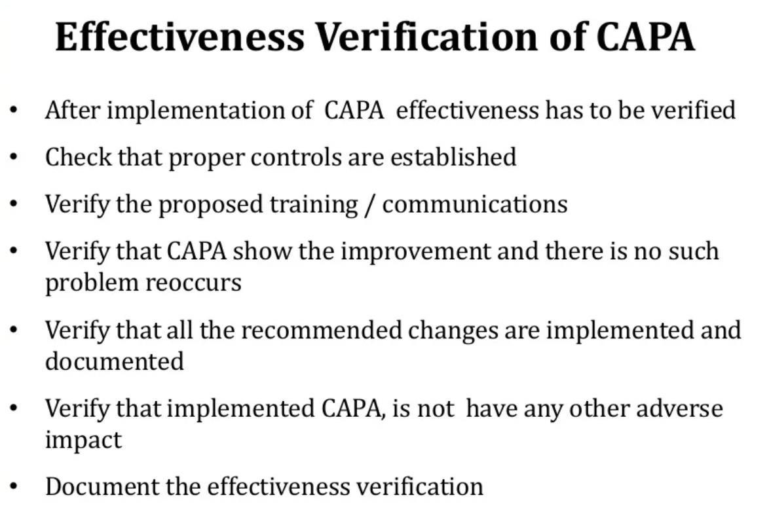

Slide 118
End of Module 5
Discussion & Questions Session
Translating root causes into corrective and preventive actions;
Assigning responsibility and timelines;
Simple RCA report structure;
Communicating findings to management.

Slide 119
Module 6
Case Study and Group Exercise
Group-based RCA on a sample incident or operational problem;
Applying 5 Whys and Fishbone;
Presenting results and receiving feedback.

Slide 120
Practical Session

Slide 121
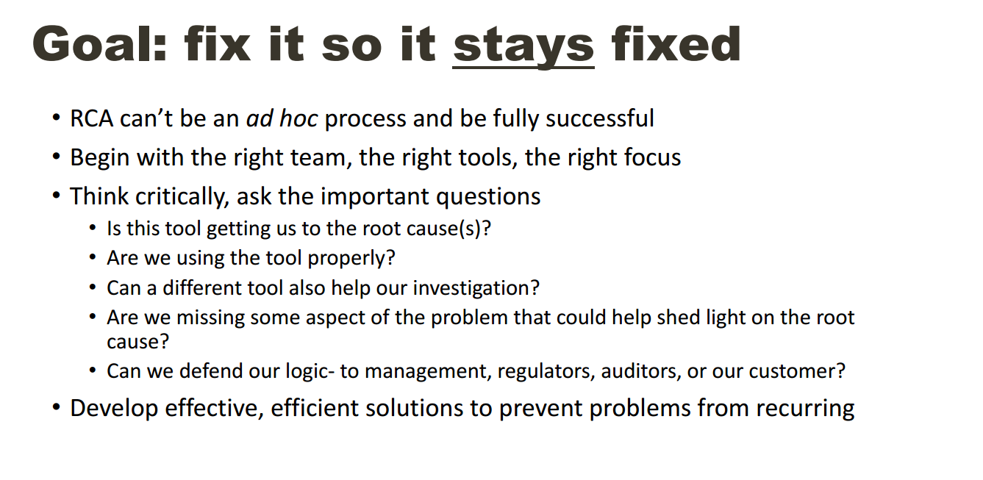

Slide 122
End of Module 6
Discussion & Questions Session
Group-based RCA on a sample incident or operational problem;
Applying 5 Whys and Fishbone;
Presenting results and receiving feedback.

